Slide 1
INTRODUCTION TO COMMUNICATION SYSTEMS - 19AIE204
Done By -
K. Vinayak (CB.EN.U4AIE19032)
Manduva Gnanadeep (CB.EN.U4AIE19041)
Prashanth VR (CB.EN.U4AIE19047)
Vuyyuru Bindu Sri (CB.EN.U4AIE19069)

Slide 2
PROBLEM STATEMENT:
To illustrate some of the properties of complex (analytic) signals and to show their importance in SSB modulation and demodulation in communications systems using Simulink. Also Demonstrating the reception of single sideband modulated signals using GRC and Simulink

Slide 3
TABLE OF CONTENTS
COMPLEX SIGNAL PROPERTIES USED IN SSB RECEPTION AND DEMODULATION
SSB RECEPTION AND DEMODULATION FLOWGRAPH
SSB IMPLEMENTATION IN GRC
SSB IMPLEMENTATION IN SIMULINK

Slide 4
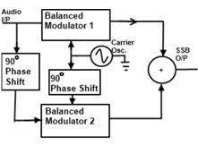
PHASE SHIFT:
The phasing method of SSB generation uses a phase shift technique that causes one of the side bands to be concealed out.
The two balanced modulator outputs are then added together algebraically. The phase shifting action causes one side band to be cancelled out when the two balanced modulator outputs are combined.

Slide 5
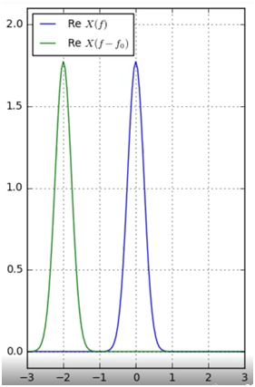

FREQUENCY SHIFTING:
Frequency shift is widely used in Fourier transform technique which generally results in modulating a signal in time domain.
As such, it is the counterpart of shifting in the time domain which corresponds to modulation in frequency domain.

Slide 6

CONVOLUTION:
Convolution is used to combine two signals to form a third signal. In Digital Signal Processing, convolution is the most important technique.

Slide 7
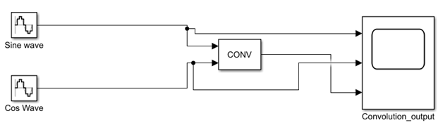
CONVOLUTION IN SIMULINK

Slide 8
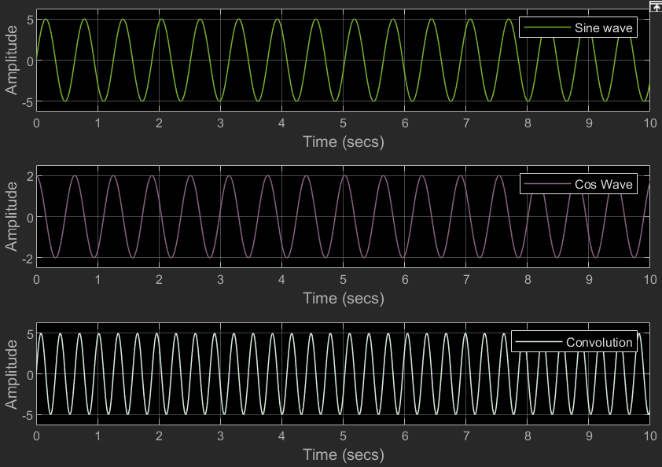

Slide 9

HILBERT TRANSFORM:
A specific linear operator that takes a function, u(t) of a real variable, and produces another function of a real variable H(u)(t) is the Hilbert transform.
HT is popularly used in the signal modulation.
The Hilbert transform on R, the real line, is defined by,

Slide 10
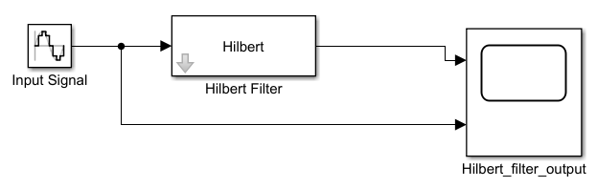
HILBERT TRANSFORM IN SIMULINK

Slide 11
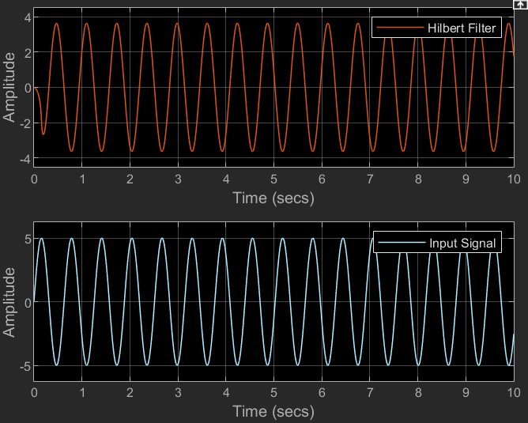

Slide 12
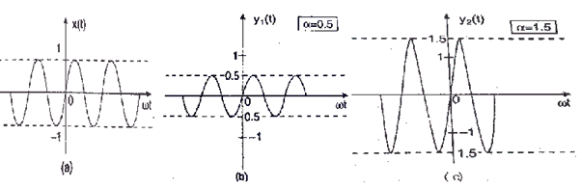
AMPLITUDE SCALING OF SIGNALS
A very basic operation performed on signals to vary its strength is the amplitude scaling. It is represented mathematically as Y(t) = α X(t).
Here, α is the scaling factor, where:-
α<1 → signal is attenuated.
α>1 → signal is amplified.

Slide 13
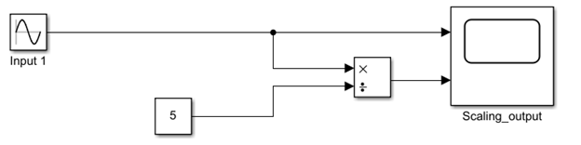
AMPLITUDE SCALING IN SIMULINK

Slide 14
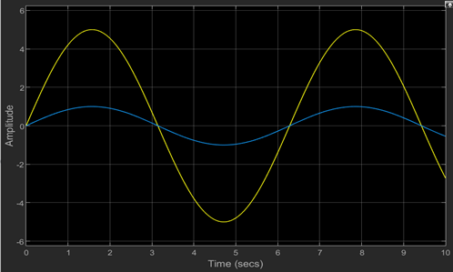
Scaling Factor < 1

Slide 15
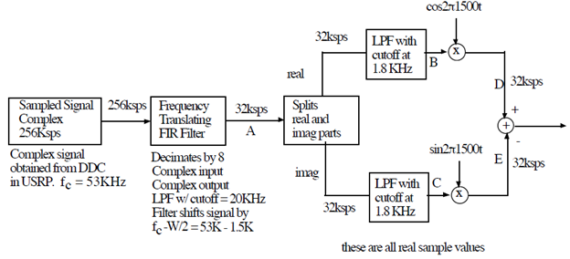
SSB RECEPTION AND DEMODULATION FLOWGRAPH

Slide 16
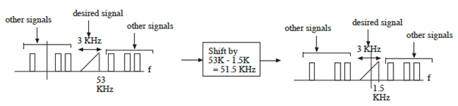
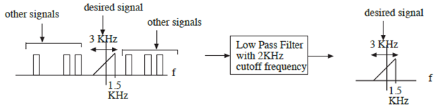
Frequency Shifting of the baseband signal
Passing the shifted signal to a Low pass filter

Slide 17
GRC MODEL FOR DEMODULATION OF COMPLEX SLSB SIGNAL

Slide 18
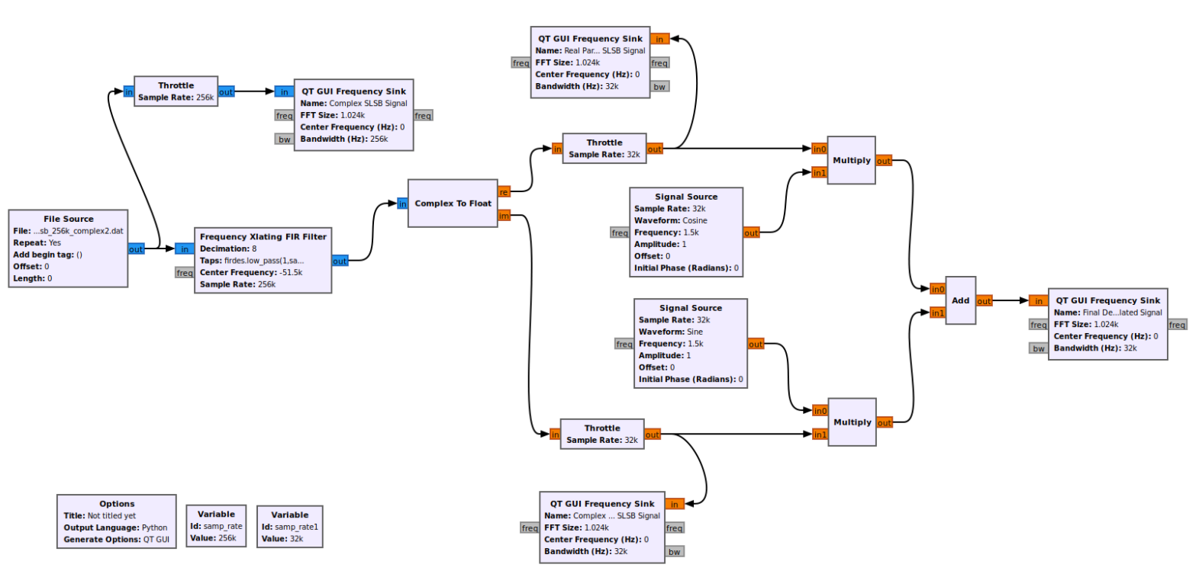

Slide 19
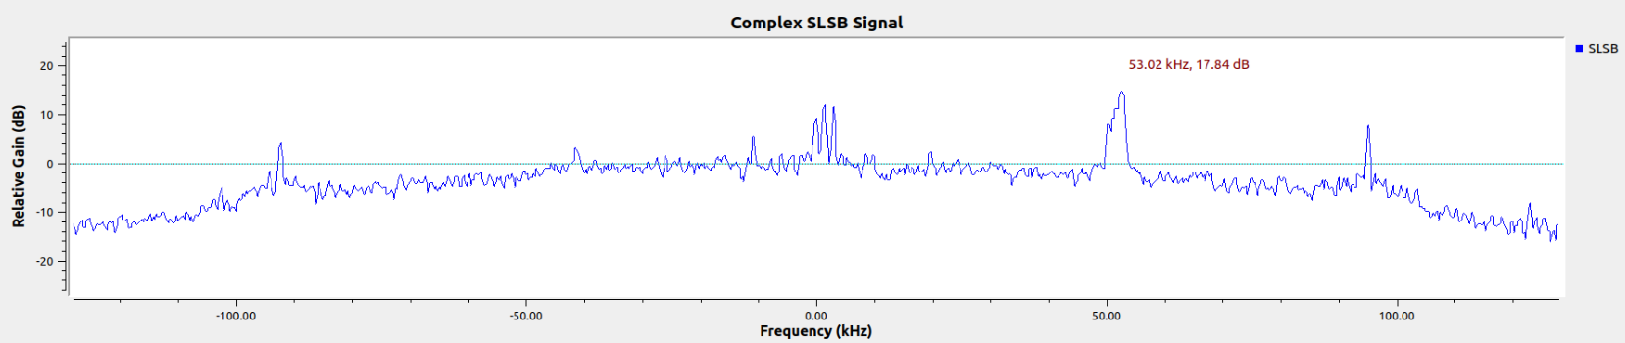
INPUT COMPLEX SLSB SIGNAL

Slide 20
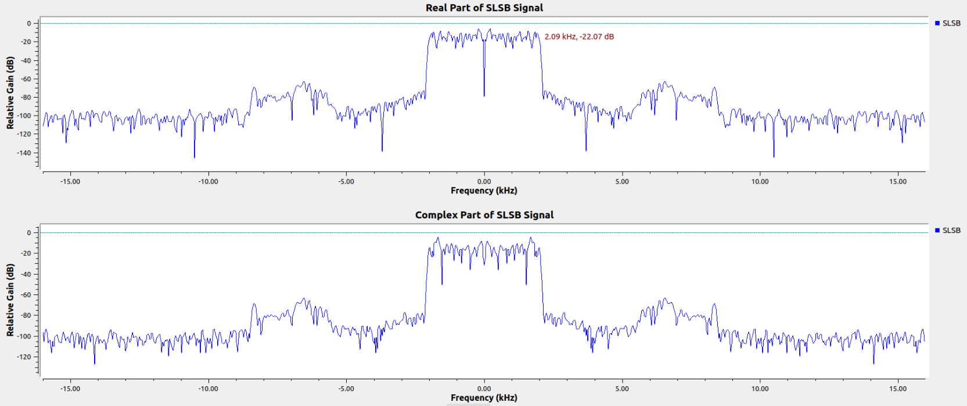
REAL AND COMPLEX PART OF SLSB SIGNAL

Slide 21
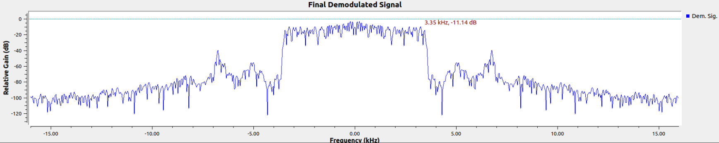
SLSB SIGNAL AFTER DEMODULATION

Slide 22
GRC MODEL FOR MODULATION AND DEMODULATION OF REAL SSB SIGNALS

Slide 23
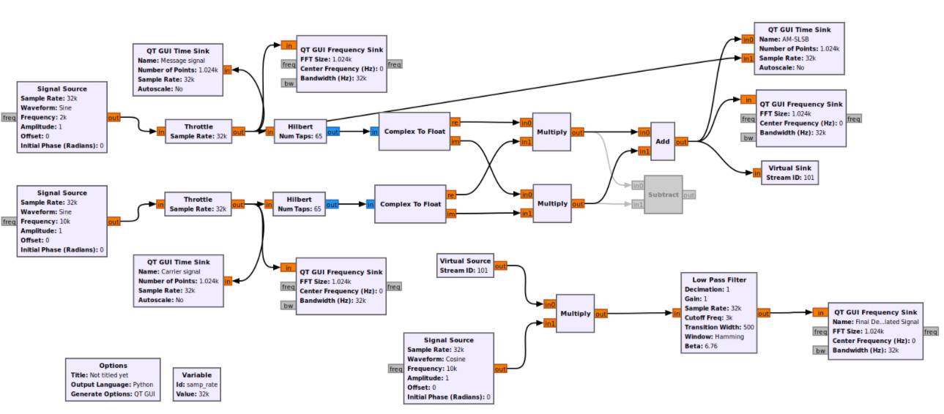

Slide 24
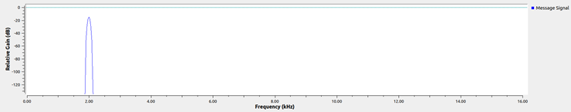
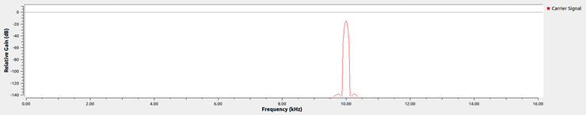
ANALYZING THE OUTPUT
Frequency spectrum of message signal
Frequency spectrum of carrier signal

Slide 25
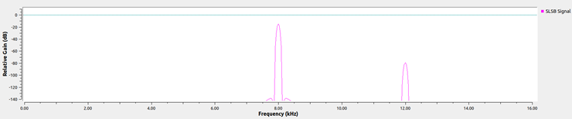
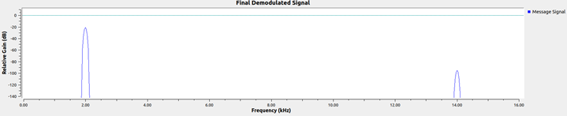
Frequency spectrum of SLSB signal
Frequency spectrum of Final demodulated signal

Slide 26
AM SSB MODULATION AND DEMODULATION IN SIMULINK

Slide 27
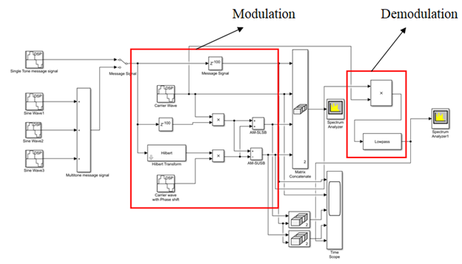

Slide 28
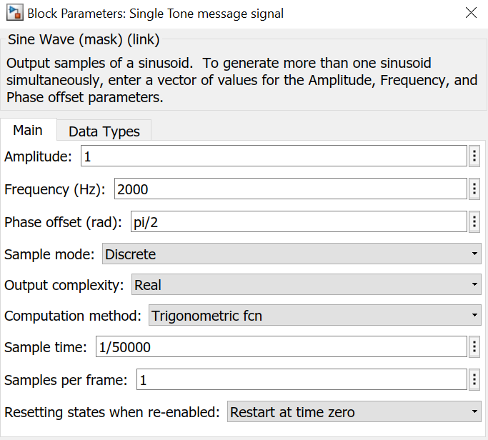
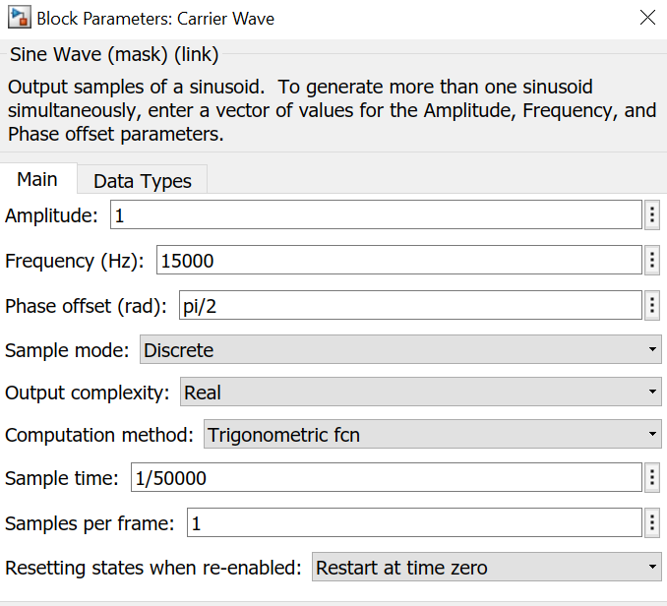
Input Parameters in Simulink

Slide 29
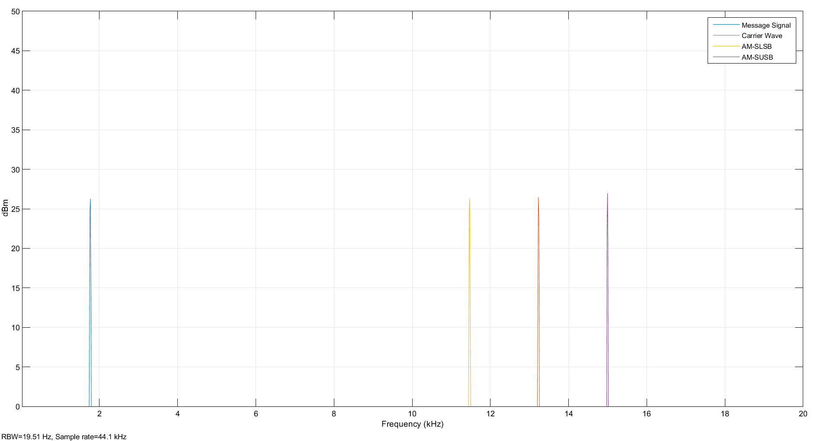
Spectrum Analyser Output of message, carrier, SLSB & SUSB signals

Slide 30
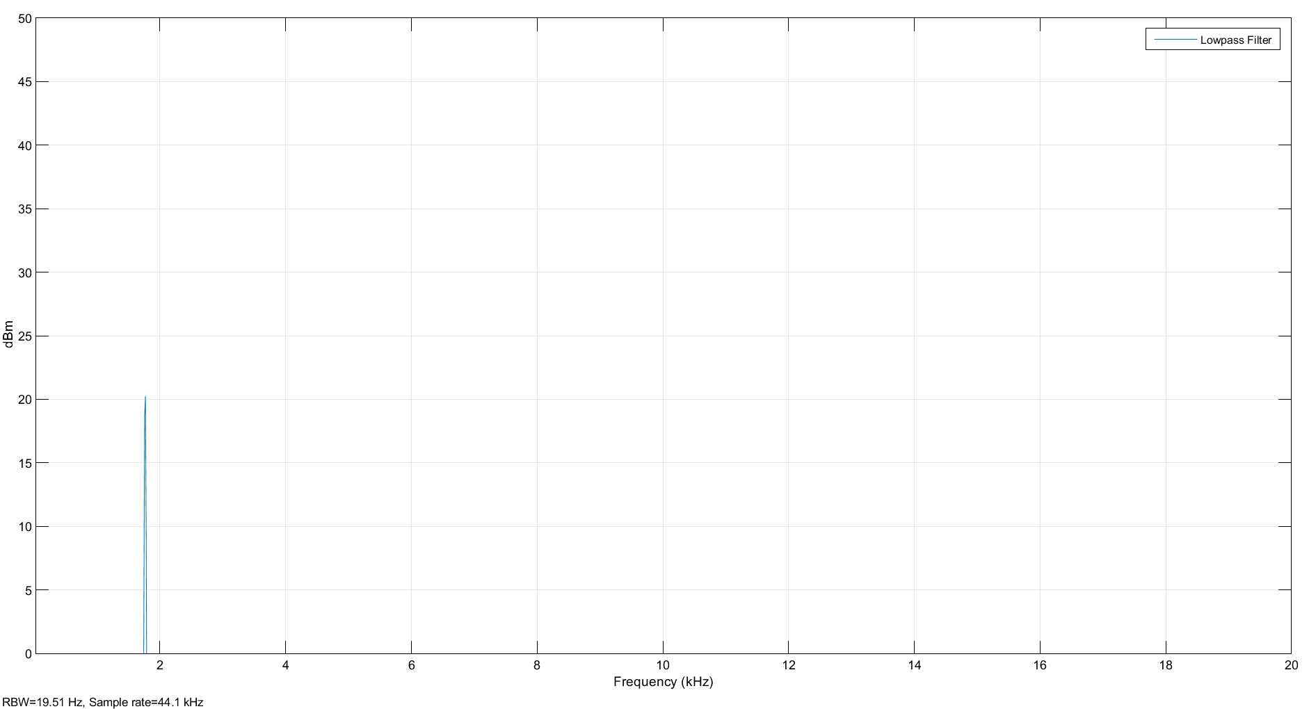
Spectrum Analyser Output of Received Signal after passing through LPF

